Slide 1



Automatic Latency Management for ROS 2: Benefits, Challenges, and Open Problems
T. Blass, A. Hamann, R. Lange, D. Ziegenbein, B. Brandenburg

Slide 2

Our Goal: Apply real-time theory to robots
Rapid Development
Timing Correctness
Real-Time Systems Theory
Large open-source robotics framework & ecosystem
Mismatch
Abstracts from technical details
Needs detailed system model to derive bounds

Slide 3
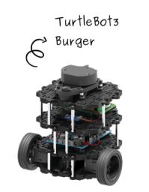
This Paper in a Nutshell
Why real-time theory is difficult to apply to ROS
Solution: The live latency manager ROS-Llama
Collect information through runtime introspection
Automatically configures real-time scheduler
Simple, declarative specification
Evaluation: Case study on a TurtleBot 3

Slide 4
Outline
Background
Why is real-time theory difficult to apply to ROS?
The ROS Live Latency Manager (ROS-Llama)
Evaluation

Slide 5
Background: ROS Pub-/Sub Mechanism
Subscriber callback
Topic /position
Publishes message
Callbacks
Triggers on message arrival
D. Casini, T. Blaß, I. Lütkebohle, and B. B. Brandenburg, “Response-Time Analysis of ROS 2 Processing Chains Under Reservation-Based Scheduling,” ECRTS 2019.

Slide 6
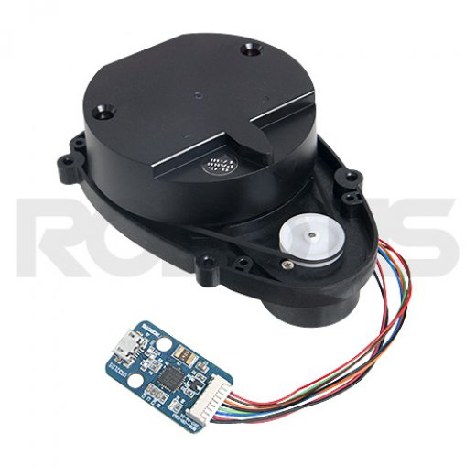
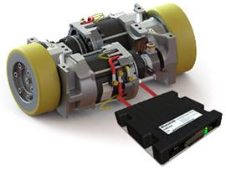

Background: Callbacks Form a Graph
Topic /engine_command
Laser Scanner
Laser Scanner
Topic /scan
Topic /position
D. Casini, T. Blaß, I. Lütkebohle, and B. B. Brandenburg, “Response-Time Analysis of ROS 2 Processing Chains Under Reservation-Based Scheduling,” ECRTS 2019.

Slide 7
Background: ROS Packages
Topic /engine_command
Laser Scanner
Topic /scan
Topic /position

Slide 8
Background: ROS Packages
Node
Topic /engine_command
Navigation Package
Laser Scanner
Topic /scan
Topic /position
Node
Developer does not need to know how the package works

Slide 9
Background: Callback Execution
Node
Node
Executor Thread
Executor Thread
Topic /scan
Topic /position
Node
Developer does not need to know how callbacks are run

Slide 10
Outline
Background
Why is real-time theory difficult to apply to ROS?
The ROS Live Latency Manager (ROS-Llama)
Evaluation

Slide 11
Why is real-time theory difficult to apply to ROS?
Requirement
Consequence
Ease of use
No need to know how included packages work
No need to know how callbacks are run
No need to know real-time theory
Cannot ask the user for the information required to bound response times
Must degrade gracefully in case of an overload
Below-worst-case provisioning
Must use mainline Linux
(+ PREEMPT_RT)
Runs on the officially supported platforms

Slide 12
Outline
Background
Why is real-time theory difficult to apply to ROS?
The ROS Live Latency Manager (ROS-Llama)
Evaluation

Slide 13
ROS-Llama: Design
Declarative Specification
ROS System
Trace Events
ROS-Llama
Linux Scheduler
Scheduler
Configuration

Slide 14
ROS-Llama: Design
Declarative Specification
ROS System
Trace Events
Model Extractor
ROS-Llama
Timing Model
Linux Scheduler
Scheduler
Configuration
Budget Manager
Timing Analysis

Slide 15
ROS-Llama: Design
Declarative Specification
ROS System
Trace Events
Model Extractor
ROS-Llama
Timing Model
Linux Scheduler
Scheduler
Configuration
Budget Manager
Timing Analysis

Slide 16
ROS-Llama: Design
Declarative Specification
ROS System
Trace Events
Model Extractor
ROS-Llama
Timing Model
Linux Scheduler
Scheduler
Configuration
Budget Manager
Timing Analysis

Slide 17
ROS-Llama: Design
Declarative Specification
ROS System
Trace Events
Model Extractor
ROS-Llama
Timing Model
Linux Scheduler
Scheduler
Configuration
Budget Manager
Timing Analysis

Slide 18
ROS-Llama: Design
Declarative Specification
ROS System
Trace Events
Model Extractor
ROS-Llama
Timing Model
Linux Scheduler
Scheduler
Configuration
Budget Manager
Timing Analysis

Slide 19
ROS-Llama: Design
Declarative Specification
ROS System
Trace Events
Model Extractor
ROS-Llama
Timing Model
Linux Scheduler
Scheduler
Configuration
Budget Manager
Timing Analysis

Slide 20
ROS-Llama: Specification
≤ 60 ms
Object classifier
Detected obstacles
Camera
Goal
Navigation package
Velocity command
End-to-end latency goals for timing-critical processing chains
Sensors
≤ 70 ms
In case of overload fail
blue chain before red chain
Degradation order

Slide 21
ROS-Llama: Design
Declarative Specification
ROS System
Trace Events
Model Extractor
ROS-Llama
Timing Model
Linux Scheduler
Scheduler
Configuration
Budget Manager
Timing Analysis

Slide 22
The Budget Manager
≤ 70 ms
Executor 2
Topic /engine_command
Executor 1
Laser Scanner
Topic /scan
Topic /position
Step 1: Find relevant callbacks
Which callbacks are part of the designated processing chain?

Slide 23
The Budget Manager
Executor 2
≤ 70 ms
Topic /engine_command
Executor 1
Laser Scanner
Topic /scan
Topic /position
Step 2: Scheduling Parameters
Which scheduling parameters for the executor threads guarantee the desired response time?

Slide 24
Background: The SCHED_DEADLINE Scheduler
Linux’s reservation-based scheduler
Each thread has a budget and a period
Threads are guaranteed to receive their budget in each period
Provides temporal isolation

Slide 25
The Budget Manager
Executor 2
≤ 70 ms
Topic /engine_command
Executor 1
Laser Scanner
Topic /scan
Topic /position
Step 2: Choose Budgets/Periods
Which scheduling parameters for the executor threads guarantee the desired response time?

Slide 26
How to Choose Budgets?
Example: Executor A
Need to bound processor demand of callback 3
Depends on number of activations per period
Depends on response-time of callback 4
Depends on budget of executor B
Executor A
Executor B
1
2
3
4
Dependency

Slide 27
How to Choose Budgets?
Example: Executor B
Need to bound processor demand of callback 2
Depends on number of activations per period
Depends on response-time of callback 1
Depends on budget of executor A
Complex global optimization problem
Solution: greedy heuristic
Open Question: Is there a better solution?
Executor A
Executor B
1
2
3
4
Dependency

Slide 28
Outline
Background
Why is real-time theory difficult to apply to ROS?
The ROS Live Latency Manager (ROS-Llama)
Evaluation

Slide 29
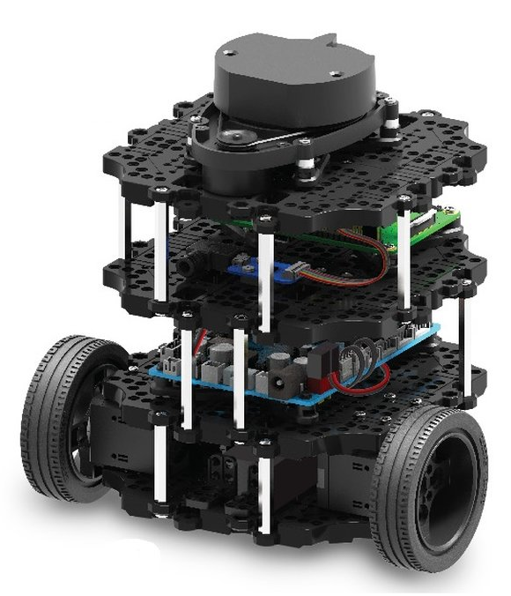
Evaluation Setup
Turtlebot 3 “Burger” controlled by a Raspberry Pi 4B
Navigation 2 package
ROS 2 Object Analytics package (Tracker)
Robot patrols between two points
Tracker load increases over time in three phases

Slide 30
Evaluation Questions
Does ROS-Llama fulfill the navigation latency goals?
What if tracker load increases (graceful degradation)?
Would a simpler solution do just as well?
Default scheduler
CFS (fair-share scheduler)
Default Linux scheduler, no configuration required
RT scheduling without analysis
SCHED_RR (fixed-priority scheduler)
Criticality-monotonic priorities for controlled degradation

Slide 31
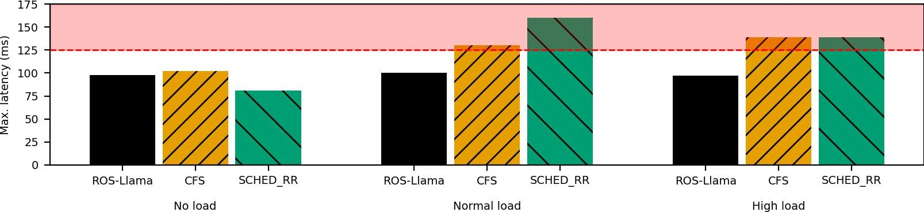
Evaluation Results: Pilot Chain
Only ROS-Llama manages latency well in all situations

Slide 32
Evaluation Results: Pilot Chain
Only ROS-Llama manages latency well in all situations
General-purpose scheduling may work better than misconfigured real-time scheduling

Slide 33
Evaluation Results: Pilot Chain
Only ROS-Llama manages latency well in all situations
General-purpose scheduling may work better than misconfigured real-time scheduling
Impact of load is complex and hard to predict without analysis

Slide 34
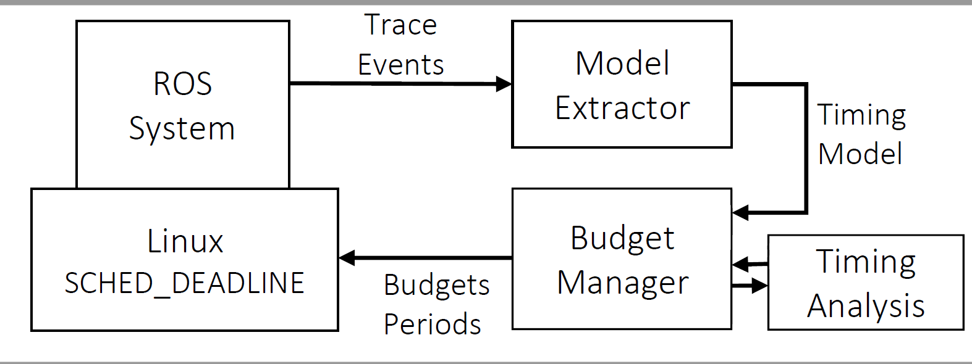
Summary
ROS-Llama: Easy, low-effort real-time scheduling for ROS
≤ 60 ms
Object classifier
Detected obstacles
Camera
Simple declarative specification
Automatic scheduler configuration at runtime
In the paper: extensive discussion of open problems
SCHED_DEADLINE limitations
Linux I/O
ROS Idiosyncrasies
Complex Activations
Stochastic Analysis
DDS Analysis

Slide 35
Applying real-time theory in robotics is difficult
Rapid Development
Timing Correctness
Real-Time Systems Theory
Large open-source robotics framework & ecosystem
Well-established theory
ROS-Llama
Abstracts details for simpler understanding and reuse
Use detailed description of the system to derive strong bounds

