Slide 1





A ROS 2 Response-Time Analysis Exploiting Starvation Freedom and Execution-Time Variance
T. Blass, D. Casini, S. Bozhko, B. Brandenburg

Slide 2

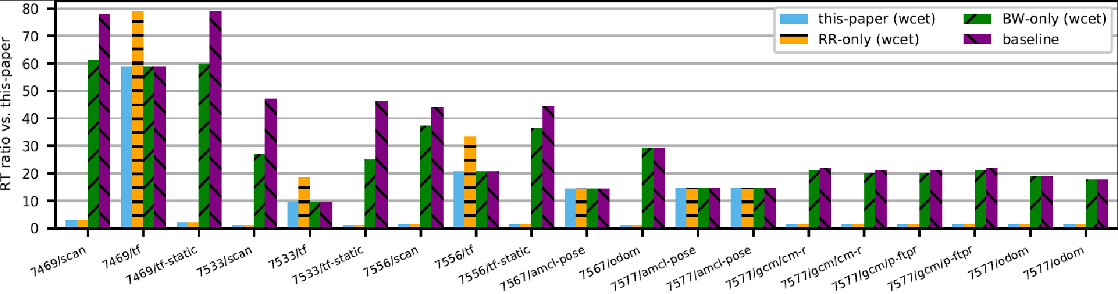
This Paper in a Nutshell
ROS 2 is one of the most popular robotics frameworks, with peculiar timing properties.
1. Address large execution-time variance over time
We improve upon existing response-time analyses with three techniques.
2. Exploit starvation-freedom in the callback scheduler
3. Improve activation-curve propagation within executors
Experiments show significant improvements (10-80x) in real-world ROS packages.

Slide 3
This Paper in a Nutshell
ROS 2 is one of the most popular robotics frameworks, with peculiar timing properties.
1. Address large execution-time variance over time
We improve upon existing response-time analyses with three techniques.
2. Exploit starvation-freedom in the callback scheduler
3. Improve activation-curve propagation within executors
Experiments show significant improvements (10-80x) in real-world ROS packages.

Slide 4

Background: ROS Callback Graph
callbacks
Topic /scan
Topic /position
Topic /update_map
triggered by

Slide 5
Background: Processing Chains
chain complete
chain triggered
Topic /scan
Topic /position
Topic /update_map

Slide 6
Background: Executing a Callback Graph
OS Process
Node
Node
Executor Thread
Executor Thread
Topic /scan
Topic /position
Topic /update_map
OS Process
Node
Executor Thread

Slide 7
Background: Compositional Performance Analysis
Per-CPU Analysis
Computes task response times given event arrival curves
Fixed-point search
Arrival-Curve Propagation
Computes event arrival curves given task response times
CPU
CPU
task
task
task
task

Slide 8
Background: Compositional Performance Analysis
Per-CPU Analysis
Computes task response times given event arrival curves
Fixed-point search
Arrival-Curve Propagation
Computes event arrival curves given task response times
CPU
CPU
task
task
task
task

Slide 9
Background: Compositional Performance Analysis
Per-CPU Analysis
Computes task response times given event arrival curves
Fixed-point search
Arrival-Curve Propagation
Computes event arrival curves given task response times
CPU
CPU
task
task
task
task

Slide 10
Background: Compositional Performance Analysis
Per-Executor Analysis
Computes callback response times given event arrival curves
Fixed-point search
Arrival-Curve Propagation
Computes event arrival curves given callback response times
Executor Thread
Executor Thread
callback
callback
callback
callback

Slide 11
Background: The ROS 2 Executor (simplified)
readySet := ready sources
in IPC Layer
no
ready callback in readySet?
yes
Execute highest-priority callback
Remove callback from readySet

Slide 12
Background: The ROS 2 Executor (simplified)
Processing Window
Polling Point
readySet := ready sources
in IPC Layer
no
ready callback in readySet?
yes
Execute highest-priority callback
Remove callback from readySet

Slide 13
Background: Peculiar Properties of the Executor
readySet := ready sources
in IPC Layer
no
ready callback in readySet?
Events only noticed at the next polling point
Only one event per processing window per source
yes
Execute highest-priority callback
Remove callback from readySet

Slide 14
This Paper in a Nutshell
ROS 2 is one of the most popular robotics frameworks, with peculiar timing properties.
1. Address large execution-time variance over time
We improve upon existing response-time analyses with three techniques.
2. Exploit starvation-freedom in the callback scheduler
3. Improve activation-curve propagation within executors
Experiments show significant improvements (10-80x) in real-world ROS packages.

Slide 15
This Paper in a Nutshell
ROS 2 is one of the most popular robotics frameworks, with peculiar timing properties.
1. Address large execution-time variance over time
We improve upon existing response-time analyses with three techniques.
2. Exploit starvation-freedom in the callback scheduler
3. Improve activation-curve propagation within executors
Experiments show significant improvements (10-80x) in real-world ROS packages.

Slide 16
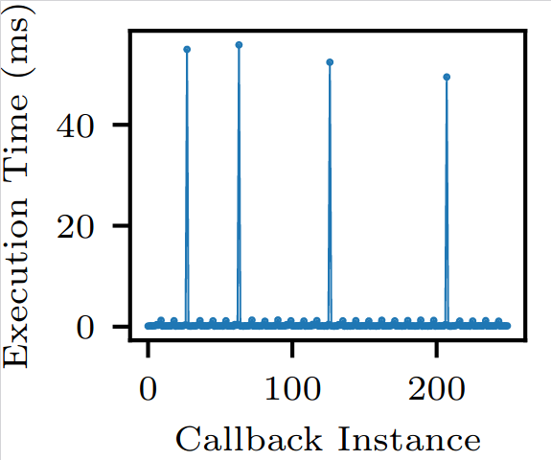
Address Large Execution-Time Variance
Problem: scalar WCET is too pessimistic
AMCL /tf callback in the navigation 2 package

Slide 17
Address Large Execution-Time Variance
Problem: scalar WCET is too pessimistic
Solution: Execution-Time Curves
(Quinton et al., 2012)
Bound execution time of multi-instance sequences
+
More precise execution-time model
-
More complex analysis
Details in the paper
AMCL /tf callback in the navigation 2 package

Slide 18
This Paper in a Nutshell
ROS 2 is one of the most popular robotics frameworks, with peculiar timing properties.
1. Address large execution-time variance over time
We improve upon existing response-time analyses with three techniques.
2. Exploit starvation-freedom in the callback scheduler
3. Improve activation-curve propagation within executors
Experiments show significant improvements (10-80x) in real-world ROS packages.

Slide 19
Problem: Bursty Callbacks
Scenario:
Callback c₁ is triggered periodically
Callback c₂ triggers bursts of 20 instances
Assume c₁’s response time < c₁’s period
Processing Window
ready callback in readySet?
yes
Execute highest-priority callback
Remove callback from readySet
Prior Work:
20 instances of c₂ in c₁’s busy window.
Pessimistic! Only one instance of c₂ runs in each processing window.

Slide 20
Solution: Round-Robin Analysis
Scenario:
Callback c₁ is triggered periodically
Callback c₂ triggers bursts of 20 instances
Assume c₁’s response time < period
Idea: count polling points
c₁ activates
c₁ completes
one polling point in this interval (per self-interfering instance of c₁)
+
Independent of c₂’s activation frequency
Incompatible with busy-window principle
-

Slide 21
Combined Analysis
Round-Robin Analysis
Busy-Window Analysis
+
Effective in executors with bursty callbacks
+
Benefits of busy-window principle
-
Lacks busy-window principle
-
Pessimistic in executors with bursty callbacks
Just try both!

Slide 22
This Paper in a Nutshell
ROS 2 is one of the most popular robotics frameworks, with peculiar timing properties.
1. Address large execution-time variance over time
We improve upon existing response-time analyses with three techniques.
2. Exploit starvation-freedom in the callback scheduler
3. Improve activation-curve propagation within executors
Experiments show significant improvements (10-80x) in real-world ROS packages.

Slide 23
Activation Curve Propagation within Executors
Activation curves are propagated with response-time jitter (Henia et. al., 2005)
𝜂₁(Δ + R₁)
𝜂₁(Δ + R₁ + R₂)
Activation curve 𝜂₁(Δ)
c₁
c₂
c₃
Δ
Rationale:
Activations of c₃ ultimately result from activations of c₁ outside the window
c₁
c₂
c₃
R₁
R₂

Slide 24
Activation Curve Propagation within Executors
If c₁, c₂, c₃ belong to the same executor and the Δ-interval starts at a quiet time:
𝜂₁(Δ)
𝜂₁(Δ)
Activation curve 𝜂₁(Δ)
c₁
c₂
c₃
Quiet time
Δ
Rationale:
Activations of c₁,c₂ cannot cross the quiet time.
previous busy-window
c₁
c₂
c₃
R₁
R₂

Slide 25
This Paper in a Nutshell
ROS 2 is one of the most popular robotics frameworks, with peculiar timing properties.
1. Address large execution-time variance over time
We improve upon existing response-time analyses with three techniques.
2. Exploit starvation-freedom in the callback scheduler
3. Improve activation-curve propagation within executors
Experiments show significant improvements (10-80x) in real-world ROS packages.

Slide 26
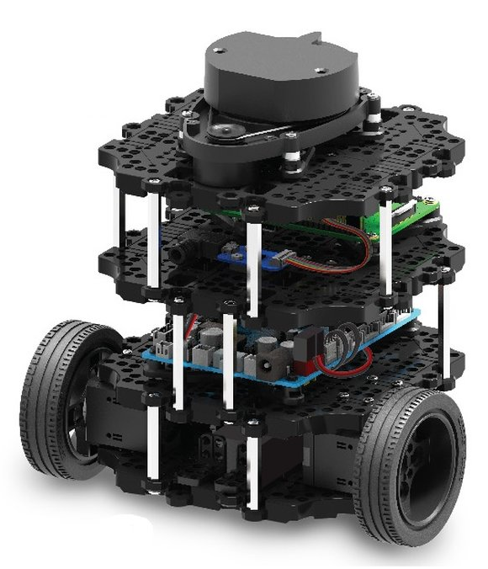
Evaluation
Turtlebot 3 “Burger” controlled by a Raspberry Pi 4B
Running various ROS packages
  Navigation 2 packages
  Turtlebot 3 drivers
Callback graph extracted from measurements
See Blass et al., “Automatic Latency Management for ROS 2: Benefits, Challenges, and Open Problems”, RTAS 2021

Slide 27
Evaluation
Casini et. al., “Response-Time Analysis of ROS 2 Processing Chains under Reservation-Based Scheduling”, ECRTS 2019

Slide 28
Evaluation
High-variance callback ⇒ Large gains from execution-time curves

Slide 29
Evaluation
Shares executor with bursty callback
⇒ Large gains from round-robin analysis

Slide 30
Evaluation
Gains over baseline in the busy-window analysis

Slide 31
Conclusion
ROS 2 is one of the most popular robotics frameworks, with peculiar timing properties.
1. Address large execution-time variance over time
We improve upon existing response-time analyses with three techniques.
2. Exploit starvation-freedom in the callback scheduler
3. Improve activation-curve propagation within executors
Experiments show significant improvements (10-80x) in real-world ROS packages.

